Slide 1
Lady Lazarus
Student Y

Slide 2
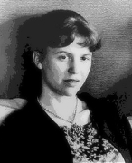
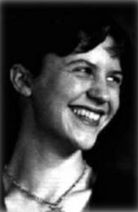
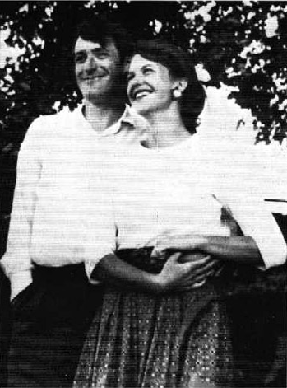
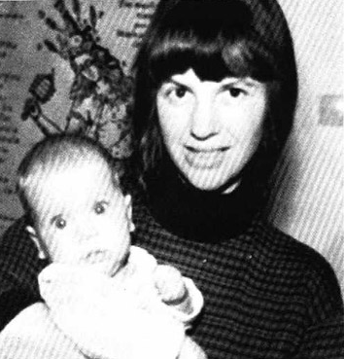
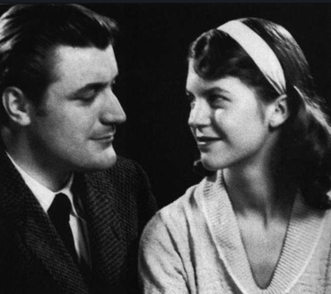
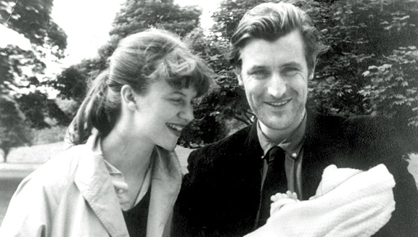
Sylvia Plath

Slide 3
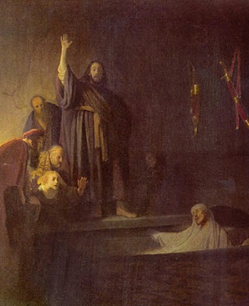
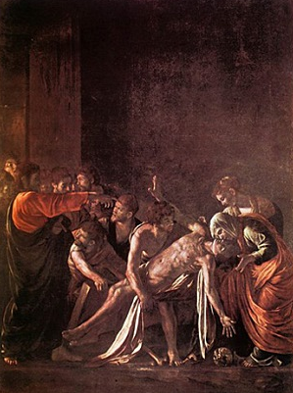
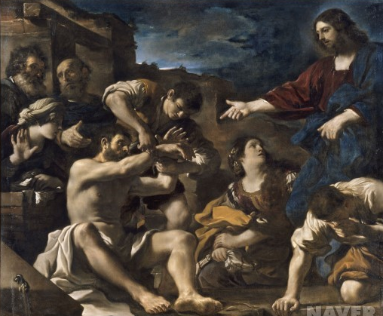
Lazarus?
NAME - A man revived by Jesus
“Lazarus, come out!”
WORD – A person who is overcoming a fail
Lazarus LADY Lazarus

Slide 4
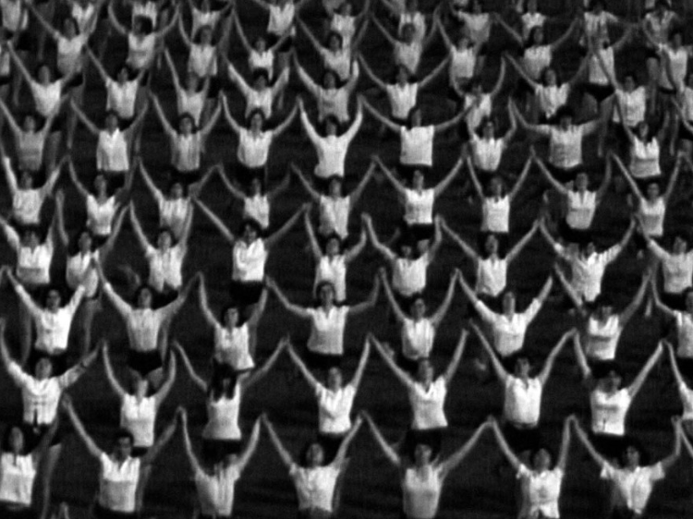
Ideology
What is ideology?
- simply, a set of belief
can be a stereotype

Slide 5
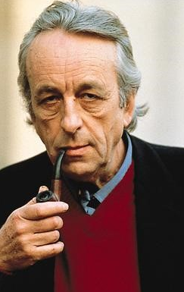
Luis Althusser - Ideology
According to Althusser ,
Ideology = last forever , even in communism
Not just a belief , it activates in real
EX) proletarian in capitalism
Symbol of imaginational relationships
about the realistic exist conditions
Reality,
Real relations
Modified, Transformed relations

Slide 6


Ideology in “Lady Lazarus”
Patriarchal ideology
- Men have all or most of the power & importance
Sylvia wanted to break down the society’s ideology

Slide 7

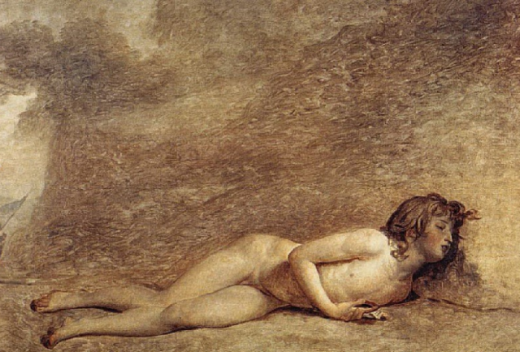
The Death of Sylvia Plath
In Plath’s Poem, Suicide is active death (not passive)
Remove male-dominated thought internalized in her ,
and finds way to liberation
Emphasizes the necessity of suicide
By dying herself, she finds her own identity

Slide 8
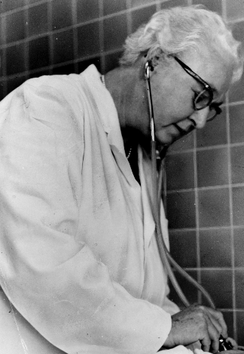
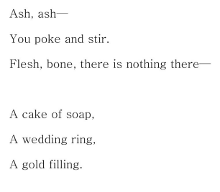
But she came out by male-doctor always
(To the same place, the same face, the same brute)
Suffer pain of suicide , a time for new-born identity, the doctor often interrupt her
Male doctor – AN OBSTRUCTOR represents patriarchal rules, reason-dominated culture
SAVAGE Man who identify her death,
materialize her identity, and break it

Slide 9


Doktor(Fruits of civilization), Enemy, God, Lucifer
She is hostile to those
‘Herr’ German word which emphasize masculinity
She The Jews
(Nazi lampshade , a paperweight)
But She Finally
Revive!

Slide 10
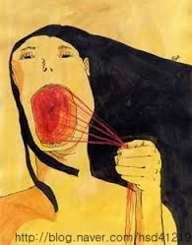

Revenge to the MEN
Collapse men-centered patriarchal order
Recover her true ego

Slide 11
THANK YOU !

